Slide 1
Simplified architecture
Flask API + web scraping using python (BeautifulSoap)

Slide 2

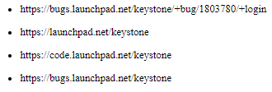
Basic flow DATA FROM THE URL WOULD FEED BELOW
information
Related links

Slide 3
Standard output
<html>
<head>
<title>{{ title }} </title>
</head>
<body>
<h1>Hello {{ title }}!</h1>
{% for url in data %}
<h4><div><p>Main URL: {{ url }} </p></div></h4>
{% for rec1 in data[url][0] %}
<div><p>{{ rec1 }}</p></div>
{% endfor %}
<h4><div><p>Links related:</p></div></h4>
{% for rec2 in data[url][1] -%}
<ul><li>{{ rec2 }}</li></ul>
{% endfor %}
{% endfor %}
</body>
</html>

